Slide 1

Karnaugh map is also called as K-map. It is developed by scientist Karnaugh; by his name, it was developed in 1953.
Karnaugh map used to simplify Boolean algebraic expressions without using Boolean theorems, While solving a Boolean expression, we usually consider Boolean laws and theorems. That may be some what typical for us. Whenever you forget those laws and theorems, you can make use of this
K-map to simplify the Boolean expression

Slide 2
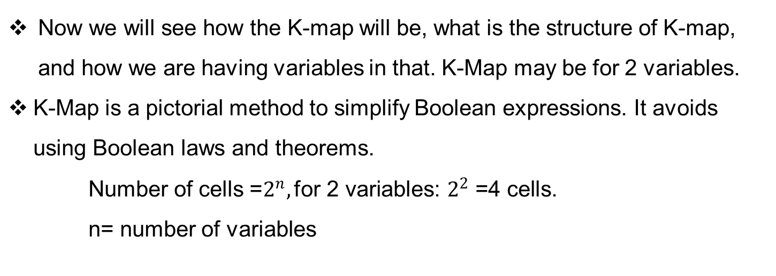

Slide 3

